Slide 1

Real-time Gas Leak Detection System with Remote Alerts
Pushpak Kore: 22231009
Priti Bagal: 22231008
Sanjana Dhumal: 22231011
Satwik Dhavale: 2223233
Himani Dhakad: 2223400

Slide 2
INTRODUCTION
“Gas leaks represent a significant and pervasive threat to life and property. Every year, incidents involving the leakage of hazardous gases such as LPG, methane, and carbon monoxide result in substantial losses. The timely and accurate detection of these gases is therefore of paramount importance in ensuring safety across a wide range of environments.
Traditional gas detection methods often rely on localized alarms or periodic manual checks. These approaches suffer from inherent limitations, notably a delayed response, which can dramatically increase the risk of fire, explosion, and health hazards. Moreover, these conventional methods lack the capability for real-time, remote monitoring and immediate notification, hindering swift action to mitigate potential disasters. This project addresses these shortcomings by presenting a low-cost, automated gas leak detection system that provides instant alerts via Telegram and incorporates continuous data logging, facilitating comprehensive monitoring and analysis of gas levels.”

Slide 3

PROBLEM STATEMENT
Existing gas leak detection methods often lack real-time monitoring and remote notification capabilities, leading to delayed responses and increased risk of gas-related accidents. This project addresses this by developing a low-cost system that provides immediate alerts and continuous data logging.

Slide 4
LITERATURE REVIEW
Raspberry Pi, a cost-effective and powerful microcomputer, enhances system performance by enabling:
Wi-Fi connectivity
Cloud data integration
Real-time data processing
Ali & Javed (2019) developed a GSM-based alert system:
Effective for SMS alerts but lacked live dashboards
Raspberry Pi supports Python, which simplifies:
Connecting gas sensors and relay modules
Automating gas valve shut-off
Sending alerts to web/mobile applications
Challenges remain, such as:
False positives
Sensor calibration issues
Network reliability
Recent research explores the use of machine learning and predictive maintenance to improve:
Accuracy
System intelligence

Slide 5
OBJECTIVES
To detect the presence of harmful gases (e.g., LPG, methane) using gas sensors like MQ-2 or MQ-135.
To use Raspberry Pi as the central controller for data processing and system management.
To provide real-time alerts to users/building managers via mobile notifications, emails, or web dashboards.
To log gas sensor data on the cloud for continuous monitoring and analysis (e.g. Thingspeak).
To build a user-friendly interface for monitoring gas levels remotely through mobile or web applications.

Slide 6
Flow Chart
Start: The system starts.
MQ2 Sensor Monitors Gas: The MQ2 sensor checks for gas.
ESP8266 Reads Sensor: The ESP8266 reads the gas level.
ESP8266 Connects to Wi-Fi & MQTT: The ESP8266 connects to the network and the message broker.
ESP8266 Publishes Data: The ESP8266 sends the gas level to the MQTT broker.
Raspberry Pi Receives Data: The Raspberry Pi gets the gas level from the broker.
Check for Alert: The Python script checks if the gas level is dangerous.
Send Alert (If Needed): If the level is high and enough time has passed since the last alert, a Telegram alert is sent.
Send Data to ThingSpeak (If Needed): If it's time to update ThingSpeak, the gas level is sent for logging and display.
Loop: The system goes back to step 3 to keep monitoring.

Slide 7
WORKING
Sensor Operation: MQ2 detects gas by a resistance change upon reaction with gas molecules at a heated sensing element.
ESP8266 Operation: Reads the MQ2's analog signal, connects to Wi-Fi, and publishes the gas level to the MQTT broker.
MQTT Communication: Mosquitto acts as a message broker, decoupling the ESP8266 (publisher) and Python script (subscriber) via topics.
Python Script Logic: Subscribes to the MQTT topic, processes gas levels, triggers Telegram alerts above a threshold, and sends data to ThingSpeak.
Alert Mechanism: A Telegram bot, controlled by the Python script and using a specific Chat ID, sends instant alert messages.
Data Logging and Visualization: ThingSpeak receives gas level data, stores it in a channel, and displays it on charts.

Slide 8

OBSERVATIONS
The MQ2 sensor provides consistent readings, with clear changes in response to gas exposure.
The ESP8266 maintains a stable connection to the Wi-Fi network and MQTT broker.
Telegram alerts are delivered promptly upon threshold breach.
Data is accurately logged and visualized on ThingSpeak.
System is stable and functional

Slide 9
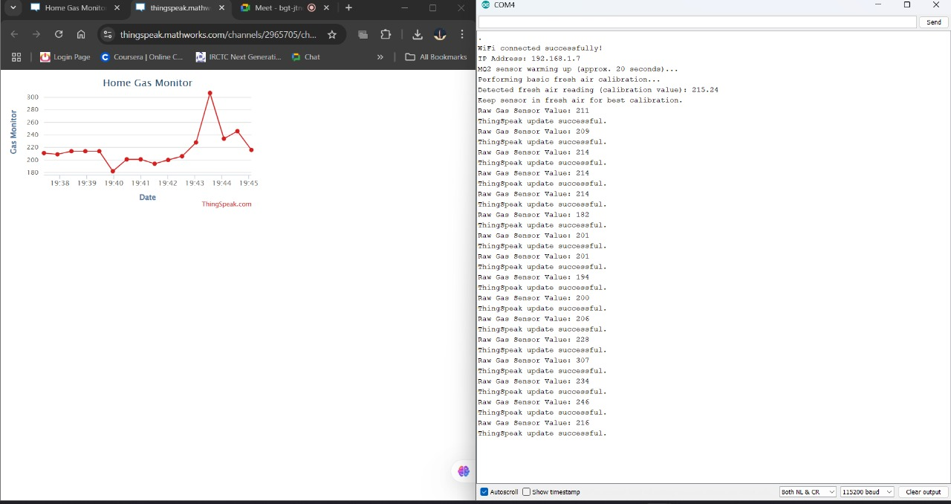
RESULT
Reading Visualization and Data Logging

Slide 10
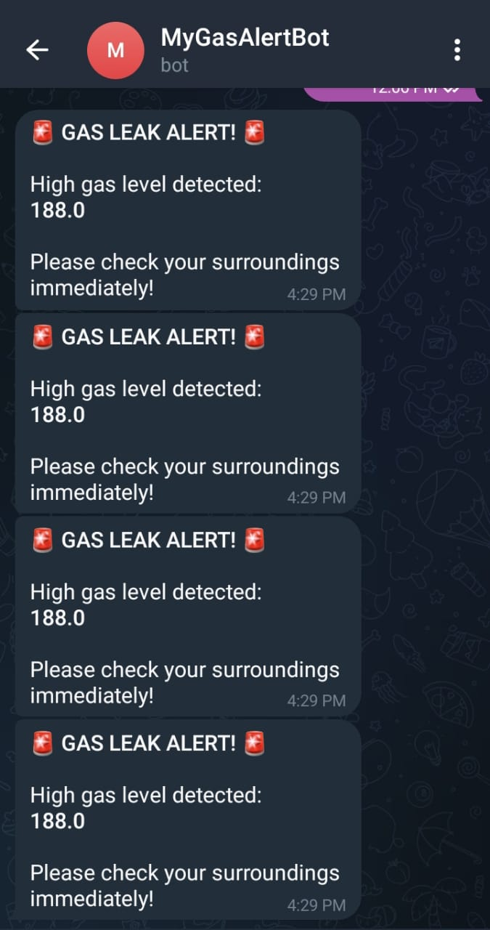
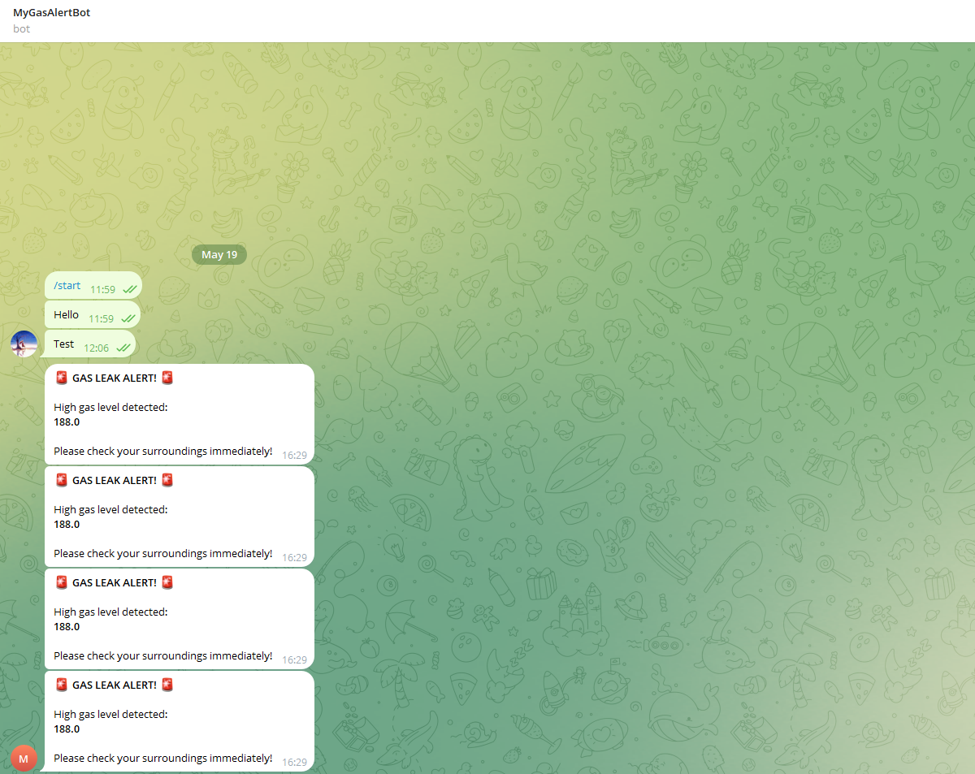
RESULT
Alert message on Desktop
Alert message on Phone

Slide 11
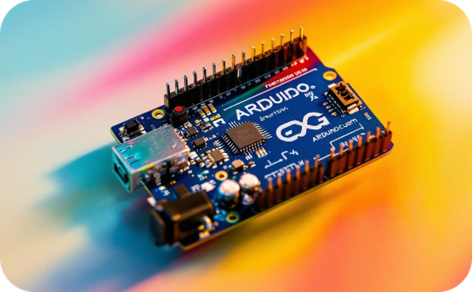
CONCLUSION
In conclusion, this project successfully demonstrates a cost-effective and reliable real-time gas leak detection system featuring remote Telegram alerts and cloud-based data logging via ThingSpeak, effectively addressing the limitations of traditional methods and enhancing safety.

Slide 12
BIBLIOGRAPHY
Kumar, A., & Sharma, R. (2020). IoT Based Gas Leakage Detection System. International Journal of Engineering Research & Technology (IJERT), 9(5), 50-53.
Ali, S., & Javed, M. (2019). Design and Implementation of Smart Gas Leakage Detection System Using GSM Module. International Journal of Computer Applications, 182(42), 12-16.
Zhao, L., et al. (2021). IoT-based Monitoring and Alert System for Smart Buildings. IEEE Internet of Things Journal, 8(12), 9820–9828.
MQ Gas Sensor Datasheets – https://www.sparkfun.com
Raspberry Pi Foundation – Getting Started with Raspberry Pi https://www.raspberrypi.org
ThingSpeak IoT Platform Documentation – https://thingspeak.com

